Slide 1
The Work of the Courts

Slide 2
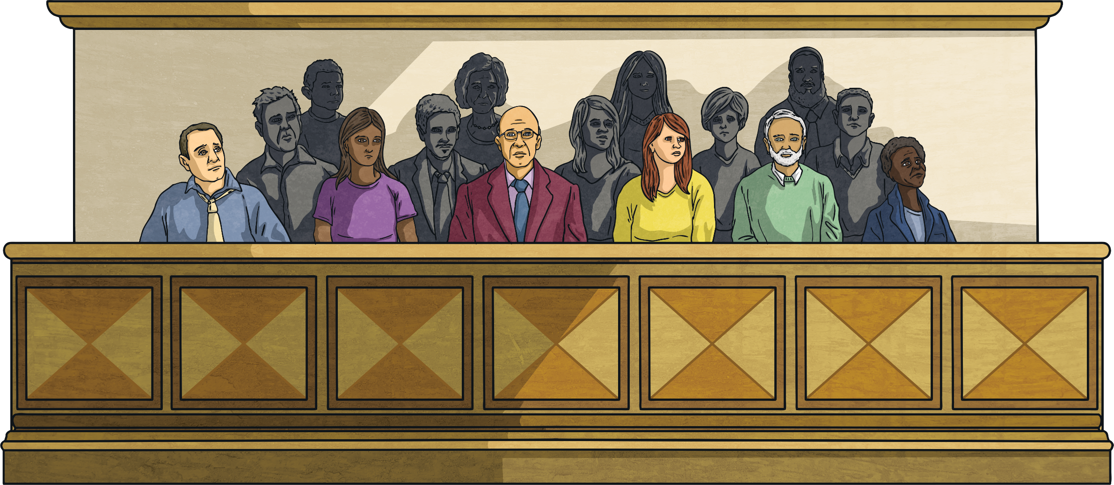
Learning Intention
To understand the work of the courts
I can …
Differentiate between Civil and Criminal Cases
Describe Court procedures
Outline the rule of evidence
Success Criteria

Slide 3

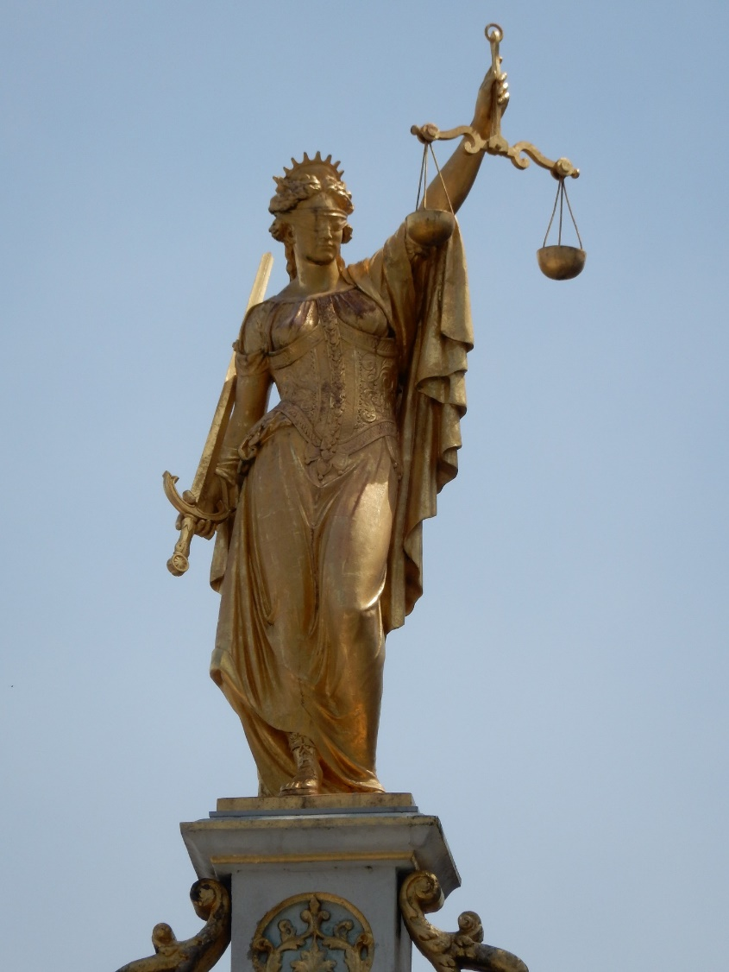
Courts’ Procedures
In order to carry out their role of resolving disputes and making judgements, courts need to listen to all the evidence presented in the case, decide on the case, and then come to a decision.
Notes:
Teacher notes: The Lady Justice is a common sight in legal institutions. Originally known as the goddess Themis, she represents the fairness of the judicial system. In Greek, Themis means 'order'.

Slide 4
Statute Law & Common Law
In Australia, most laws are made by parliament. In fact the main role of the state and federal parliaments is to make laws. This form of legislation is referred to as Statute law.
Courts also have an important role in the law making process. Sometimes courts are faced with cases where there is no existing law that is appropriate to apply. In these cases, judges must create new law, known as common law.

Slide 5


Watch the video
Notes:
Skip intro and start at 19 seconds
YouTube – HSC Legal Studies: Common Law and Statute Law
https://www.youtube.com/watch?v=pc6PENVnxoU

Slide 6

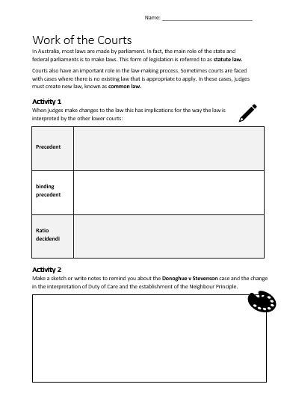
Activity Sheet
5 minute
Task
Make notes on the Key Terms used in Common Law on the following slide in Activity 1 on your activity sheet.

Slide 7
Key Terms used in Common Law
Precedent | A law or rule that other courts must use when deciding on cases with similar circumstances or facts.
binding precedent | all inferior courts are bound to follow the new precedent e.g. if the High Court sets the precedent all other courts in Australia must follow it.
Ratio decidendi | when using a precedent previously set it is important for courts to look at exactly how and why the particular court that set the precedent came to reach that decision this helped the court understand the reason behind the judgement which is that it's to their own cases as appropriate.

Slide 8
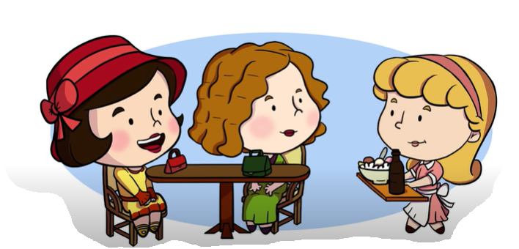
Donoghue v Stevenson
5 minute
Task
Watch the video to see example of precedent in this famous case. Then complete Activity 2.
Notes:
https://www.youtube.com/watch?v=evDCHCMRAtc

Slide 9
Neighbour Principle
“You must take reasonable care to avoid acts or omissions which you can reasonably foresee would be likely to injure your neighbour.”
Manufacturers have a legal duty of care to the ultimate consumers of their products if it is not possible for defects to be identified before the goods are received.

Slide 10
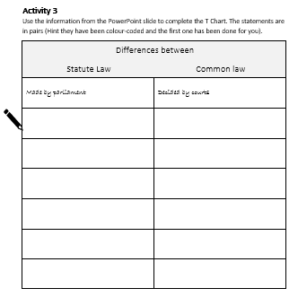
Activity Sheet
5 minute
Task
Activity 3
Use the information statements on the following slide, together with the T Chart graphic organiser to show the differences between Statue and Common Law.
Hint: the pairs of statements are colour coded.

Slide 11
Makes decisions to address cases that have already occurred. These decisions can sometimes affect future decisions
Decided by courts
Made by parliament
Bound by precedent and legislation
Covers broad areas
Bound by the Constitution
Only applies to the parties involved
Court decisions can be overridden by parliament or higher courts
Passes laws that affect the future
Can delegate legislation to state/local governments
Covers issues/facts specific to the individual case
Applies to the whole community
Courts cannot delegate their powers
Parliament is the highest authority

Slide 12
Differences between
Statute Law | Common law
Made by parliament | Decided by courts
Bound by the Constitution | Bound by precedent and legislation
Applies to the whole community | Only applies to the parties involved
Covers broad areas | Covers issues/facts specific to the individual case
Parliament is the highest authority | Court decisions can be overridden by parliament or higher courts
Can delegate legislation to state/local governments | Courts cannot delegate their powers
Passes laws that affect the future | Makes decisions to address cases that have already occurred. These decisions can sometimes affect future decisions

Slide 13

Classifying the Law
Whilst the courts can create law, the main role of the courts is to apply and interpret the meaning of any existing laws.
There are two types of law:
Criminal law
Civil law

Slide 14
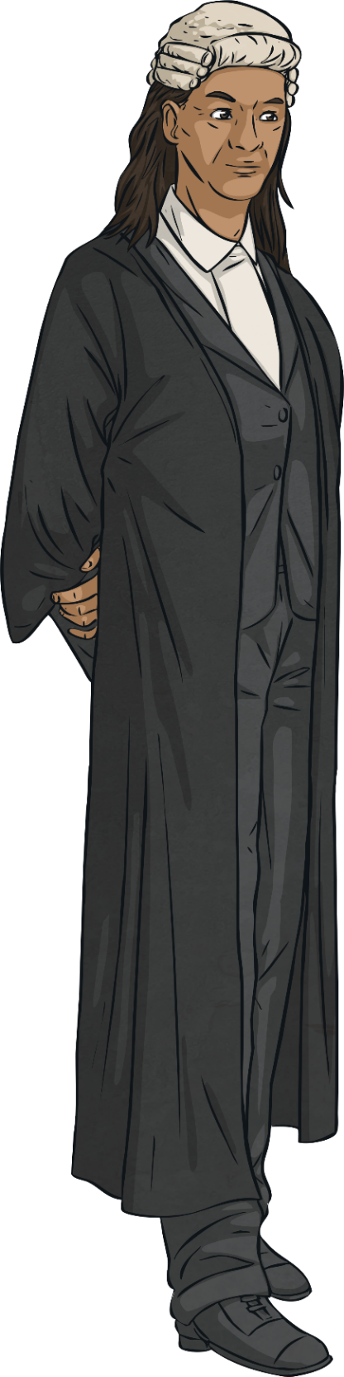
Criminal Law
Criminal offences are regarded as offences against society. It includes the punishment of people who break these laws.
It deals with matters such as:
Crimes against people:
E.g. murder, assault
Property crimes:
E.g. theft, burglary, fraud and vandalism

Slide 15
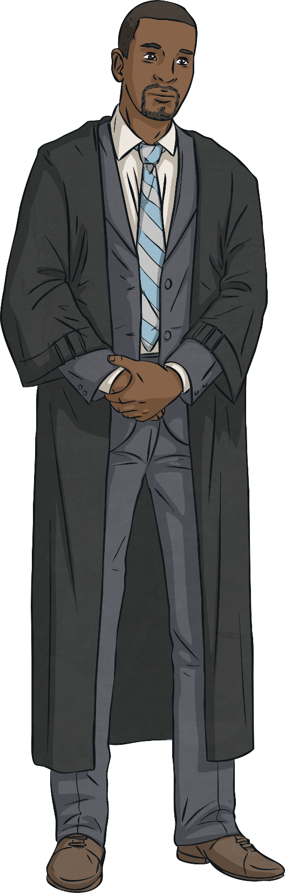
Civil Law
Civil law is concerned with the rights and duties of citizens in dealings with other citizens.
Civil law covers activities such as:
Lending and borrowing money
Entering into contracts
Disputes with neighbours
Getting married
Inheritances and wills

Slide 16
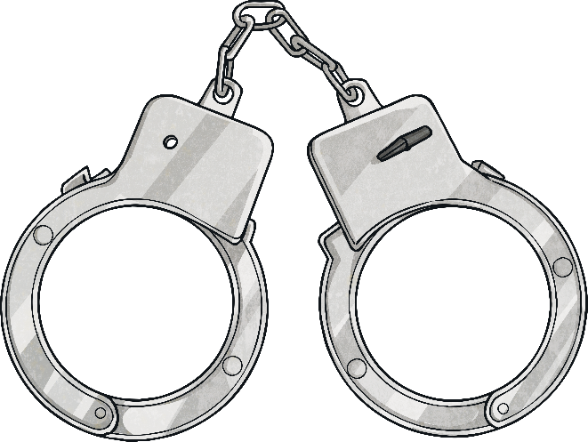
Compensation or Punishment?
In civil law, the courts award compensation when someone can prove the other party is in the wrong.
In criminal courts, the aim is to punish wrongdoers and impose a sentence which prevents them from reoffending.
Compensation
This refers to the act of providing a person with money or other things of value in order to provide for the costs of injuries that they have incurred.
Sentence
This can generally involve imprisonment, a fine and/or other punishments against a defendant convicted of a crime.

Slide 17
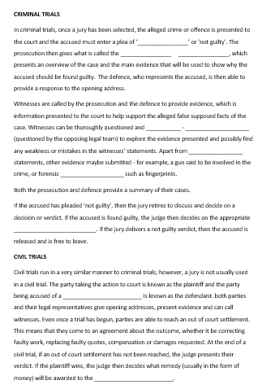
Activity Sheet
5 minute
Task
Complete Activity 4 – Cloze Activity

Slide 18
Rules of Evidence
In both criminal and civil trials, all the parties must ensure that they follow the strict rules of evidence and court procedures. It is the judges job to make sure these rules and procedures all followed.
The rules of evidence include that the information provided must be factual and not just somebody's opinion, and that all evidence presented by police needs to be gained legally. A judge may order that someone be removed from the court if they are disrupting proceedings or acting in a manner that might put others at risk. The judges can also, if it is proved that someone has given false evidence, have them charged with perjury, that is lying to the court.

Slide 19
Activity Sheet
5 minute
Task
Activity 5 – Write the categories of evidence in the table
on your activity sheet, then match with the examples given.
Category of Evidence |  | Example
Real |  | a type of real evidence, describ­es letters, contracts, newspapers, anything with human language
Demonstrative |  | oral or written evidence from victims, suspects and witnesses involved with the case
Documentary |  | any actual object that was directly involved in an event in the case
Testimonial |  | an illustration of evidence -- something like a map of the crime scene

Slide 20
Learning Review
I can …
Differentiate between Civil and Criminal Cases
Describe Court procedures
Outline the rule of evidence
Success Criteria

